Slide 1
Data Mining Project
Group 15 –
Di Lena Francesco, Emiliano Quaranta, Alessandro Querci

Slide 2
Data Understanding
Verified type of attributes in the dataset:
Wrong type(object type)
(Ex. n_participants_child/teen/adult,
max/average/min_age_participants)
Semantic errors:
negative values for age attributes,
coordinates outside USA territory,
future years (ex. 2028, 2029)
Missing Values
Some attributes have a big portion of their data set to NULL (Ex. address/n_participant_age1/street_house_district)
Task 1

Slide 3
Data understanding
Duplicates
Dropped duplicates based on a subset of important features
Management of missing and unknown values
Removed n_participant values set to zero (probable default value)
Removed some rows with NULL values (ex. Longitude, latitude)
Substituted NULL values for data that we could calculate (ex. N_arrested, n_unharmed)
Task 1

Slide 4
Data preparation
Dropped attributes that were not useful for our analysis (ex. n_participant_age1, participant_gender1)
Data trasformation
Transformed incident_characteristics1/2 into incident_category with predetermined categories
Transformed date field in three different attributes (day, month, year)
Cut rows with invalid value on the Year field
Task 1

Slide 5
Data preparation
Extracted features from ones already present in the dataset
Task 1

Slide 6
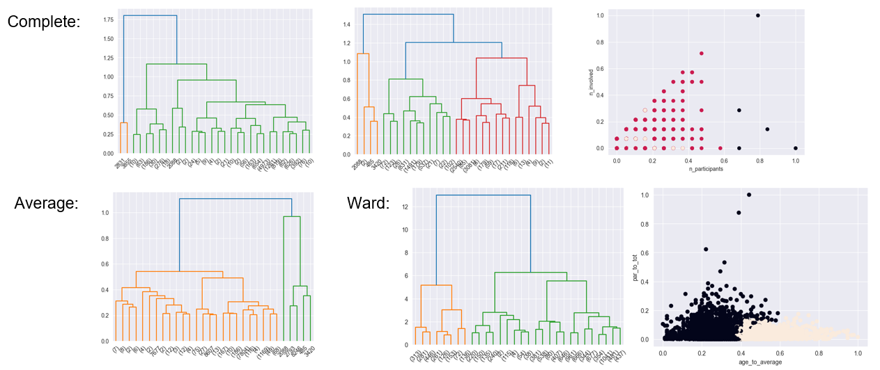
hierarchical
Task 2

Slide 7
kmeans
Task 2

Slide 8
dbscan
Task 2

Slide 9
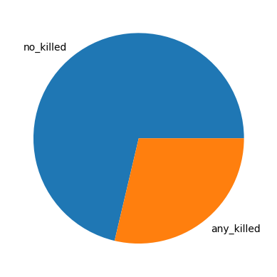
Predictive Analysis
We added a variable isKilled as label for the classification.
Since the label distribution was around 70:30 we tested with and without oversampling with SMOTE
We split the dataset into training, validation and test sets for cross validation with a 70/15/15 ratio and scaled them with Standard Scaler.
The following classifiers were tested:
KNN
Bayes-Naive (Bernoulli and Gaussian)
SVM with various kernels
Neural Networks
Decision Tree and Random Forest
Task 3

Slide 10
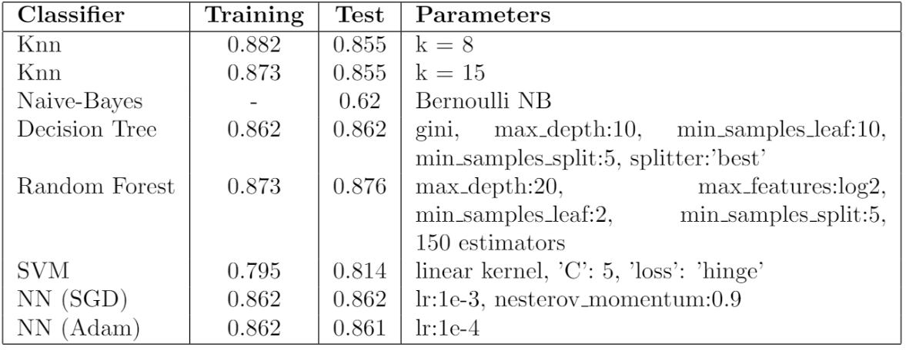
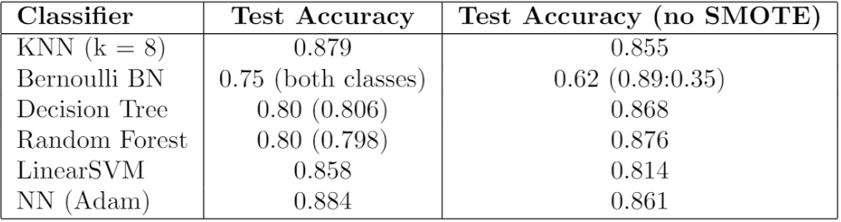
Predictive Analysis
KNN's k was chosen as tradeoff between training and validation scores of k
A grid search was made for Decision Trees, Random Forest and Linear SVMs
For the NNs we tried both a grid search with sklearn and then manual tuning with keras
After applying SMOTE to balance the dataset, another parameter search was attempted for DTs
Oversampling increased accuracy overall on the models, DTs had increased recall but lower precision
Task 3

Slide 11
Time Series - Preprocessing
Filtered years from 2014 to 2017, added feature is_killed, mapped city_or_county to standardized values.
score = n participants + n injured + n killed * ( 2+ (n_killed/n_participants)) – n_unharmed/4
Filtered to cities only with at least 25% of weeks having an incident
Task 4

Slide 12
Time Series - analysis
Tested for stationarity. Since it wasn’t detected, we applied denoising and normalization.
Clustered Time series using both Shape-based and Feature-based Kmeans. We also applied Hierarchical clustering using the ward method.
Shape-based Kmeans returned balanced clusters. Feature-based Kmeans unbalanced ones. Hierarchical returned two clusters.
No big difference was found in the clusters.
Task 4

Slide 13
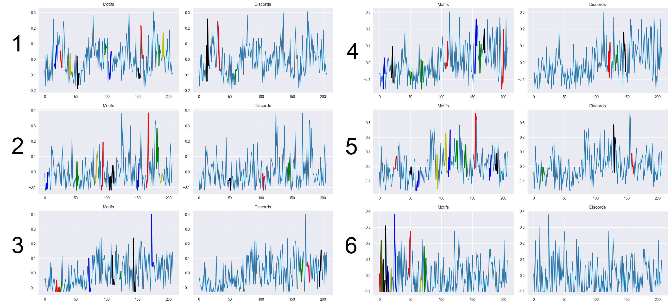
Motifs and anomalies
Task 4

Slide 14
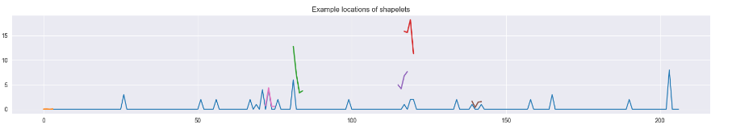
shapelets
Score = (2 * n_minors) + (n_participants – n_minors). Is_killed True if someone was killed in the city
Used Grabocka heuristics to find size and number of shapelets.
Then trained a shapelet model using LearningShapelets library from tslearn.
Task 4

